Slide 1
Learn Its – Step 9
5+9=14
Fact Family
1x2=2
2x2=4
3x2=6
4x2=8
5x2=10
6x2=12
7x2=14
8x2=16
9x2=18
10x2=20
11x2=22
12x2=24
6+9=15
Jumbled Tables
7+9=16
Say Table
5+7=12
Say Multiples 1 - 10
5+8=13
Say Multiples 1 - 5
6+8=14

Slide 2
1 | 2 | 3 | 4 | 5 | 6 | 7 | 8 | 9 | 10
11 | 12 | 13 | 14 | 15 | 16 | 17 | 18 | 19 | 20
21 | 22 | 23 | 24 | 25 | 26 | 27 | 28 | 29 | 30
31 | 32 | 33 | 34 | 35 | 36 | 37 | 38 | 39 | 40
41 | 42 | 43 | 44 | 45 | 46 | 47 | 48 | 49 | 50
51 | 52 | 53 | 54 | 55 | 56 | 57 | 58 | 59 | 60
61 | 62 | 63 | 64 | 65 | 66 | 67 | 68 | 69 | 70
71 | 72 | 73 | 74 | 75 | 76 | 77 | 78 | 79 | 80
81 | 82 | 83 | 84 | 85 | 86 | 87 | 88 | 89 | 90
91 | 92 | 93 | 94 | 95 | 96 | 97 | 98 | 99 | 100

Slide 3
1 | 2 | 3 | 4 | 5 | 6 | 7 | 8 | 9 | 10
11 | 12 | 13 | 14 | 15 | 16 | 17 | 18 | 19 | 20
21 | 22 | 23 | 24 | 25 | 26 | 27 | 28 | 29 | 30
31 | 32 | 33 | 34 | 35 | 36 | 37 | 38 | 39 | 40
41 | 42 | 43 | 44 | 45 | 46 | 47 | 48 | 49 | 50
51 | 52 | 53 | 54 | 55 | 56 | 57 | 58 | 59 | 60
61 | 62 | 63 | 64 | 65 | 66 | 67 | 68 | 69 | 70
71 | 72 | 73 | 74 | 75 | 76 | 77 | 78 | 79 | 80
81 | 82 | 83 | 84 | 85 | 86 | 87 | 88 | 89 | 90
91 | 92 | 93 | 94 | 95 | 96 | 97 | 98 | 99 | 100

Slide 4
2
4
6
8
10
12
14
16
18
20

Slide 5
2
4
6
8
10
12
14
16
18
20

Slide 6
0
2
4
6
8
10
12
14
16
18
20

Slide 7
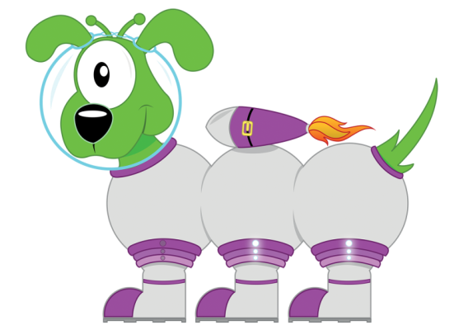
Get your whiteboards ready!!
X2 Multiplication Facts

Slide 8
Let’s wire the numbers up!!
16
x÷
2
8

Slide 9
Let’s wire the numbers up!!
16
x÷
2
8

Slide 10
Let’s wire the numbers up!!
18
x÷
2
9

Slide 11
Let’s wire the numbers up!!
18
x÷
2
9

Slide 12
Let’s wire the numbers up!!
14
x÷
7
2

Slide 13
Let’s wire the numbers up!!
14
x÷
7
2

Slide 14
Let’s wire the numbers up!!
12
x÷
6
2

Slide 15
Let’s wire the numbers up!!
12
x÷
6
2

Slide 16
Let’s wire the numbers up!!
24
x÷
2
12

Slide 17
Let’s wire the numbers up!!
24
x÷
2
12

Slide 18
Get your whiteboards ready!!

Slide 19
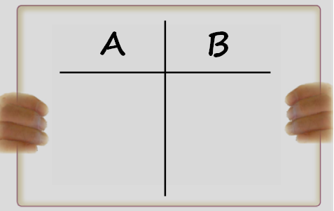

Slide 20
A | B
6x2 | 8x2

Slide 21
12
16

Slide 22
A | B
11x2 | 2x5

Slide 23
22
20

Slide 24
A | B
14÷2 | 12x2

Slide 25
7
24

Slide 26
A | B
20÷2 | 12÷2

Slide 27
10
6

Slide 28
A | B
4x20 | 8x0.2
Changing the ‘thing’!
This is
more challenging!

Slide 29
80
1.6

Slide 30
9 x 2 = 18

Slide 31
9 x 2 = 18

Slide 32
7 x 2 = 14

Slide 33
7 x 2 = 14

Slide 34
12 x 2 = 24

Slide 35
12 x 2 = 24

Slide 36
22 ÷ 2 = 11

Slide 37
22 ÷ 2 = 11

Slide 38
18 ÷ 2 = 9

Slide 39
18 ÷ 2 = 9

Slide 40
100 ÷ 2 = 50

Slide 41
100 ÷ 2 = 50

Slide 42
How many questions can you answer in 12 seconds!!

Slide 43
Get your whiteboards ready!!

Slide 45
Time’s up!
8x2
14÷2
6x =12
22÷ =2

Slide 46
16
7
2
11

Slide 47
Let’s try that again.

Slide 49
Time’s up!
2x9
16÷2
2x =14
24÷ =2

Slide 50
18
8
7
12

Slide 51
Get your whiteboards ready!!
Addition Learn Its

Slide 52
Let’s wire the numbers up!!
14
+-
5
9

Slide 53
Let’s wire the numbers up!!
14
+-
5
9

Slide 54
Let’s wire the numbers up!!
15
+-
6
9

Slide 55
Let’s wire the numbers up!!
15
+-
6
9

Slide 56
Let’s wire the numbers up!!
16
+-
7
9

Slide 57
Let’s wire the numbers up!!
16
+-
7
9

Slide 58
Let’s wire the numbers up!!
12
+-
5
7

Slide 59
Let’s wire the numbers up!!
12
+-
5
7

Slide 60
Let’s wire the numbers up!!
13
+-
8
5

Slide 61
Let’s wire the numbers up!!
13
+-
8
5

Slide 62
Let’s wire the numbers up!!
14
+-
6
8

Slide 63
Let’s wire the numbers up!!
14
+-
6
8

Slide 64
Get your whiteboards ready!!

Slide 66
A | B
6+9 | 5+7

Slide 67
15
12

Slide 68
A | B
5+8 | 7+9

Slide 69
13
16

Slide 70
A | B
5+9 | 6+8

Slide 71
14
14

Slide 72
A | B
600+900 | 0.7+0.9
Changing the ‘thing’!
This is
more challenging!

Slide 73
1500
1.6

Slide 74
6 + 9 = 15

Slide 75
6 + 9 = 15

Slide 76
5 + 7 = 12

Slide 77
5 + 7 = 12

Slide 78
6 + 8 = 14

Slide 79
6 + 8 = 14

Slide 80
16 - 7 = 9

Slide 81
16 - 7 = 9

Slide 82
13 - 8 = 5

Slide 83
13 - 8 = 5

Slide 84
14 - 6 = 8

Slide 85
14 - 6 = 8

Slide 86
How many questions can you answer in 12 seconds!!

Slide 87
Get your whiteboards ready!!

Slide 89
Time’s up!
5+7
8+6
8+ =13
14- =5

Slide 90
12
14
5
9

Slide 91
Let’s try that again.

Slide 93
Time’s up!
6+9
13-5
9+ =15
14- =6

Slide 94
15
8
6
8

