Slide 1
Learn Its – Step 14
Fact Family
1x11=11
2x11=22
3x11=33
4x11=44
5x11=55
6x11=66
7x11=77
8x11=88
9x11=99
10x11=110
11x11=121
12x11=132
Jumbled Tables
Say Table
Say Multiples 1 - 10
Say Multiples 1 - 5

Slide 2
1 | 2 | 3 | 4 | 5 | 6 | 7 | 8 | 9 | 10
11 | 12 | 13 | 14 | 15 | 16 | 17 | 18 | 19 | 20
21 | 22 | 23 | 24 | 25 | 26 | 27 | 28 | 29 | 30
31 | 32 | 33 | 34 | 35 | 36 | 37 | 38 | 39 | 40
41 | 42 | 43 | 44 | 45 | 46 | 47 | 48 | 49 | 50
51 | 52 | 53 | 54 | 55 | 56 | 57 | 58 | 59 | 60
61 | 62 | 63 | 64 | 65 | 66 | 67 | 68 | 69 | 70
71 | 72 | 73 | 74 | 75 | 76 | 77 | 78 | 79 | 80
81 | 82 | 83 | 84 | 85 | 86 | 87 | 88 | 89 | 90
91 | 92 | 93 | 94 | 95 | 96 | 97 | 98 | 99 | 100

Slide 3
1 | 2 | 3 | 4 | 5 | 6 | 7 | 8 | 9 | 10
11 | 12 | 13 | 14 | 15 | 16 | 17 | 18 | 19 | 20
21 | 22 | 23 | 24 | 25 | 26 | 27 | 28 | 29 | 30
31 | 32 | 33 | 34 | 35 | 36 | 37 | 38 | 39 | 40
41 | 42 | 43 | 44 | 45 | 46 | 47 | 48 | 49 | 50
51 | 52 | 53 | 54 | 55 | 56 | 57 | 58 | 59 | 60
61 | 62 | 63 | 64 | 65 | 66 | 67 | 68 | 69 | 70
71 | 72 | 73 | 74 | 75 | 76 | 77 | 78 | 79 | 80
81 | 82 | 83 | 84 | 85 | 86 | 87 | 88 | 89 | 90
91 | 92 | 93 | 94 | 95 | 96 | 97 | 98 | 99 | 100

Slide 4
0
11
22
33
44
55
66
77
88
99
110

Slide 5
11
22
33
44
55
66
77
88
99
110

Slide 6
11
22
33
44
55
66
77
88
99
110

Slide 7
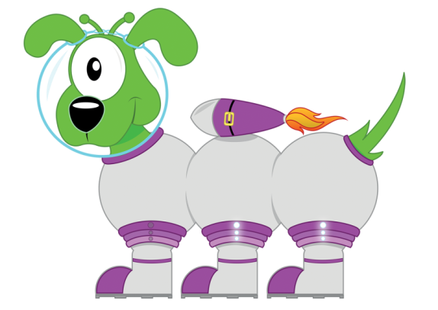
Get your whiteboards ready!!
X11 Multiplication Facts

Slide 8
Let’s wire the numbers up!!
55
x÷
5
11

Slide 9
Let’s wire the numbers up!!
55
x÷
5
11

Slide 10
Let’s wire the numbers up!!
77
x÷
7
11

Slide 11
Let’s wire the numbers up!!
77
x÷
7
11

Slide 12
Let’s wire the numbers up!!
110
x÷
10
11

Slide 13
Let’s wire the numbers up!!
110
x÷
10
11

Slide 14
Let’s wire the numbers up!!
132
x÷
12
11

Slide 15
Let’s wire the numbers up!!
132
x÷
12
11

Slide 16
Let’s wire the numbers up!!
66
x÷
6
11

Slide 17
Let’s wire the numbers up!!
66
x÷
6
11

Slide 18
Get your whiteboards ready!!

Slide 20
A | B
4x11 | 9x11

Slide 21
44
99

Slide 22
A | B
6x11 | 11x11

Slide 23
66
121

Slide 24
A | B
33÷11 | 77÷11

Slide 25
3
7

Slide 26
A | B
132÷11 | 88÷11

Slide 27
12
8

Slide 28
A | B
5x1100 | 7x0.11
Changing the ‘thing’!
This is
more challenging!

Slide 29
5500
0.77

Slide 30
4 x 11 = 44

Slide 31
4 x 11 = 44

Slide 32
7 x 11 = 77

Slide 33
7 x 11 = 77

Slide 34
12 x 11 = 132

Slide 35
12 x 11 = 132

Slide 36
88 ÷ 11 = 8

Slide 37
88 ÷ 11 = 8

Slide 38
110 ÷ 11 = 10

Slide 39
110 ÷ 11 = 10

Slide 40
7.7 ÷ 11 = 0.7

Slide 41
7.7 ÷ 11 = 0.7

Slide 42
How many questions can you answer in 12 seconds!!

Slide 43
Get your whiteboards ready!!

Slide 45
Time’s up!
9x11
88÷11
11x =66
55÷ =11

Slide 46
99
8
6
6

Slide 47
Let’s try that again.

Slide 49
Time’s up!
11x12
55÷11
11x =110
99÷ =9

Slide 50
132
5
10
11

