Slide 1
Learn Its – Step 10
Fact Family
1x3=3
2x3=6
3x3=9
4x3=12
5x3=15
6x3=18
7x3=21
8x3=24
9x3=27
10x3=30
11x3=33
12x3=36
Jumbled Tables
Say Table
Say Multiples 1 - 10
Say Multiples 1 - 5

Slide 2
1 | 2 | 3 | 4 | 5 | 6 | 7 | 8 | 9 | 10
11 | 12 | 13 | 14 | 15 | 16 | 17 | 18 | 19 | 20
21 | 22 | 23 | 24 | 25 | 26 | 27 | 28 | 29 | 30
31 | 32 | 33 | 34 | 35 | 36 | 37 | 38 | 39 | 40
41 | 42 | 43 | 44 | 45 | 46 | 47 | 48 | 49 | 50
51 | 52 | 53 | 54 | 55 | 56 | 57 | 58 | 59 | 60
61 | 62 | 63 | 64 | 65 | 66 | 67 | 68 | 69 | 70
71 | 72 | 73 | 74 | 75 | 76 | 77 | 78 | 79 | 80
81 | 82 | 83 | 84 | 85 | 86 | 87 | 88 | 89 | 90
91 | 92 | 93 | 94 | 95 | 96 | 97 | 98 | 99 | 100

Slide 3
1 | 2 | 3 | 4 | 5 | 6 | 7 | 8 | 9 | 10
11 | 12 | 13 | 14 | 15 | 16 | 17 | 18 | 19 | 20
21 | 22 | 23 | 24 | 25 | 26 | 27 | 28 | 29 | 30
31 | 32 | 33 | 34 | 35 | 36 | 37 | 38 | 39 | 40
41 | 42 | 43 | 44 | 45 | 46 | 47 | 48 | 49 | 50
51 | 52 | 53 | 54 | 55 | 56 | 57 | 58 | 59 | 60
61 | 62 | 63 | 64 | 65 | 66 | 67 | 68 | 69 | 70
71 | 72 | 73 | 74 | 75 | 76 | 77 | 78 | 79 | 80
81 | 82 | 83 | 84 | 85 | 86 | 87 | 88 | 89 | 90
91 | 92 | 93 | 94 | 95 | 96 | 97 | 98 | 99 | 100

Slide 4
3
6
9
12
15
18
21
24
27
30

Slide 5
3
6
9
12
15
18
21
24
27
30

Slide 6
0
3
6
9
12
15
18
21
24
27
30

Slide 7
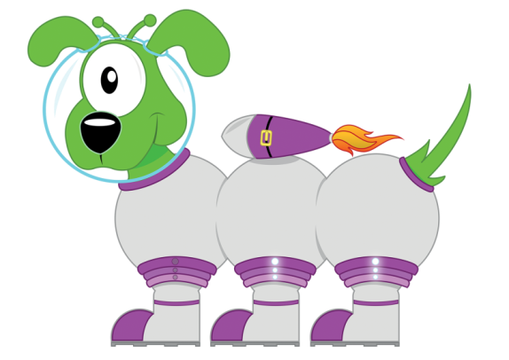
Get your whiteboards ready!!
X3 Multiplication Facts

Slide 8
Let’s wire the numbers up!!
15
x÷
3
5

Slide 9
Let’s wire the numbers up!!
15
x÷
3
5

Slide 10
Let’s wire the numbers up!!
27
x÷
3
9

Slide 11
Let’s wire the numbers up!!
27
x÷
3
9

Slide 12
Let’s wire the numbers up!!
21
x÷
7
3

Slide 13
Let’s wire the numbers up!!
21
x÷
7
3

Slide 14
Let’s wire the numbers up!!
36
x÷
12
3

Slide 15
Let’s wire the numbers up!!
36
x÷
12
3

Slide 16
Let’s wire the numbers up!!
30
x÷
3
10

Slide 17
Let’s wire the numbers up!!
30
x÷
3
10

Slide 18
Get your whiteboards ready!!

Slide 20
A | B
6x3 | 8x3

Slide 21
18
24

Slide 22
A | B
11x3 | 3x7

Slide 23
33
21

Slide 24
A | B
15÷3 | 27÷3

Slide 25
5
9

Slide 26
A | B
36÷3 | 12÷3

Slide 27
12
4

Slide 28
A | B
4x300 | 9x0.3
Changing the ‘thing’!
This is
more challenging!

Slide 29
1200
2.7

Slide 30
6 x 3 = 18

Slide 31
6 x 3 = 18

Slide 32
7 x 3 = 21

Slide 33
7 x 3 = 21

Slide 34
12 x 3 = 36

Slide 35
12 x 3 = 36

Slide 36
33 ÷ 3 = 11

Slide 37
33 ÷ 3 = 11

Slide 38
27 ÷ 3 = 9

Slide 39
27 ÷ 3 = 9

Slide 40
120 ÷ 3 = 40

Slide 41
120 ÷ 3 = 40

Slide 42
How many questions can you answer in 12 seconds!!

Slide 43
Get your whiteboards ready!!

Slide 45
Time’s up!
8x3
15÷3
6x =18
27÷ =3

Slide 46
24
5
3
9

Slide 47
Let’s try that again.

Slide 49
Time’s up!
12x3
21÷3
3x =30
33÷ =3

Slide 50
36
7
10
11

