Slide 1
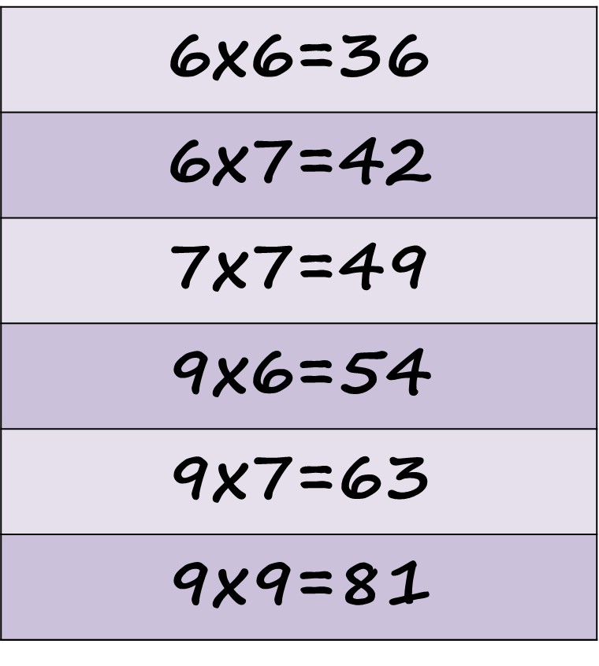
Learn Its – Step 13
It’s the
6 Fact Challenge

Slide 2
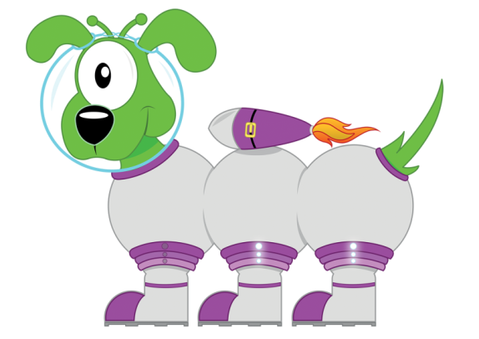
Get your whiteboards ready!!
The 6 Fact Challenge

Slide 3
Let’s wire the numbers up!!
36
x÷
6
6

Slide 4
Let’s wire the numbers up!!
36
x÷
6
6

Slide 5
Let’s wire the numbers up!!
42
x÷
6
7

Slide 6
Let’s wire the numbers up!!
42
x÷
6
7

Slide 7
Let’s wire the numbers up!!
49
x÷
7
7

Slide 8
Let’s wire the numbers up!!
49
x÷
7
7

Slide 9
Let’s wire the numbers up!!
54
x÷
9
6

Slide 10
Let’s wire the numbers up!!
54
x÷
9
6

Slide 11
Let’s wire the numbers up!!
63
x÷
7
9

Slide 12
Let’s wire the numbers up!!
63
x÷
7
9

Slide 13
Let’s wire the numbers up!!
81
x÷
9
9

Slide 14
Let’s wire the numbers up!!
81
x÷
9
9

Slide 15
Get your whiteboards ready!!

Slide 17
A | B
6x6 | 9x9

Slide 18
36
81

Slide 19
A | B
6x7 | 9x7

Slide 20
42
63

Slide 21
A | B
7x7 | 9x6

Slide 22
49
54

Slide 23
A | B
42÷6 | 49÷7

Slide 24
7
7

Slide 25
A | B
54÷6 | 81÷9

Slide 26
9
9

Slide 27
A | B
36÷6 | 63÷9

Slide 28
6
7

Slide 29
A | B
6x700 | 9x0.06
Changing the ‘thing’!
This is
more challenging!

Slide 30
4200
0.54

Slide 31
6 x 7 = 42

Slide 32
6 x 7 = 42

Slide 33
7 x 7 = 49

Slide 34
7 x 7 = 49

Slide 35
9 x 7 = 63

Slide 36
9 x 7 = 63

Slide 37
36 ÷ 6 = 6

Slide 38
36 ÷ 6 = 6

Slide 39
49 ÷ 7 = 7

Slide 40
49 ÷ 7 = 7

Slide 41
5.4 ÷ 9 = 0.6

Slide 42
5.4 ÷ 9 = 0.6

Slide 43
How many questions can you answer in 12 seconds!!

Slide 44
Get your whiteboards ready!!

Slide 46
Time’s up!
9x9
42÷6
9x =63
49÷ =7

Slide 47
81
7
7
7

Slide 48
Let’s try that again.

Slide 50
Time’s up!
9x6
36÷6
7x =63
42÷ =7

Slide 51
54
6
9
6

