Slide 1
Learn Its – Step 12
Fact Family
1x8=8
2x8=16
3x8=24
4x8=32
5x8=40
6x8=48
7x8=56
8x8=64
9x8=72
10x8=80
11x8=88
12x8=96
Jumbled Tables
Say Table
Say Multiples 1 - 10
Say Multiples 1 - 5

Slide 2
1 | 2 | 3 | 4 | 5 | 6 | 7 | 8 | 9 | 10
11 | 12 | 13 | 14 | 15 | 16 | 17 | 18 | 19 | 20
21 | 22 | 23 | 24 | 25 | 26 | 27 | 28 | 29 | 30
31 | 32 | 33 | 34 | 35 | 36 | 37 | 38 | 39 | 40
41 | 42 | 43 | 44 | 45 | 46 | 47 | 48 | 49 | 50
51 | 52 | 53 | 54 | 55 | 56 | 57 | 58 | 59 | 60
61 | 62 | 63 | 64 | 65 | 66 | 67 | 68 | 69 | 70
71 | 72 | 73 | 74 | 75 | 76 | 77 | 78 | 79 | 80
81 | 82 | 83 | 84 | 85 | 86 | 87 | 88 | 89 | 90
91 | 92 | 93 | 94 | 95 | 96 | 97 | 98 | 99 | 100

Slide 3
1 | 2 | 3 | 4 | 5 | 6 | 7 | 8 | 9 | 10
11 | 12 | 13 | 14 | 15 | 16 | 17 | 18 | 19 | 20
21 | 22 | 23 | 24 | 25 | 26 | 27 | 28 | 29 | 30
31 | 32 | 33 | 34 | 35 | 36 | 37 | 38 | 39 | 40
41 | 42 | 43 | 44 | 45 | 46 | 47 | 48 | 49 | 50
51 | 52 | 53 | 54 | 55 | 56 | 57 | 58 | 59 | 60
61 | 62 | 63 | 64 | 65 | 66 | 67 | 68 | 69 | 70
71 | 72 | 73 | 74 | 75 | 76 | 77 | 78 | 79 | 80
81 | 82 | 83 | 84 | 85 | 86 | 87 | 88 | 89 | 90
91 | 92 | 93 | 94 | 95 | 96 | 97 | 98 | 99 | 100

Slide 4
0
8
16
24
32
40
48
56
64
72
80

Slide 5
8
16
24
32
40
48
56
64
72
80

Slide 6
8
16
24
32
40
48
56
64
72
80

Slide 7
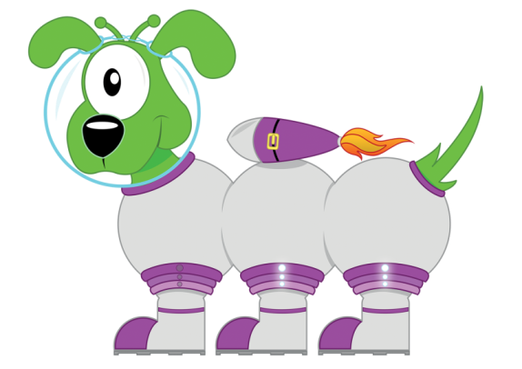
Get your whiteboards ready!!
X8 Multiplication Facts

Slide 8
Let’s wire the numbers up!!
24
x÷
3
8

Slide 9
Let’s wire the numbers up!!
24
x÷
3
8

Slide 10
Let’s wire the numbers up!!
40
x÷
5
8

Slide 11
Let’s wire the numbers up!!
40
x÷
5
8

Slide 12
Let’s wire the numbers up!!
56
x÷
7
8

Slide 13
Let’s wire the numbers up!!
56
x÷
7
8

Slide 14
Let’s wire the numbers up!!
96
x÷
12
8

Slide 15
Let’s wire the numbers up!!
96
x÷
12
8

Slide 16
Let’s wire the numbers up!!
48
x÷
6
8

Slide 17
Let’s wire the numbers up!!
48
x÷
6
8

Slide 18
Get your whiteboards ready!!

Slide 20
A | B
3x8 | 5x8

Slide 21
24
40

Slide 22
A | B
6x8 | 9x8

Slide 23
48
72

Slide 24
A | B
32÷8 | 56÷8

Slide 25
4
7

Slide 26
A | B
80÷8 | 96÷8

Slide 27
10
12

Slide 28
A | B
3x8000 | 6x0.08
Changing the ‘thing’!
This is
more challenging!

Slide 29
24000
0.48

Slide 30
3 x 8 = 24

Slide 31
3 x 8 = 24

Slide 32
7 x 8 = 56

Slide 33
7 x 8 = 56

Slide 34
9 x 8 = 72

Slide 35
9 x 8 = 72

Slide 36
48 ÷ 8 = 6

Slide 37
48 ÷ 8 = 6

Slide 38
88 ÷ 8 = 11

Slide 39
88 ÷ 8 = 11

Slide 40
5.6 ÷ 8 = 0.7

Slide 41
5.6 ÷ 8 = 0.7

Slide 42
How many questions can you answer in 12 seconds!!

Slide 43
Get your whiteboards ready!!

Slide 45
Time’s up!
8x8
80÷8
8x =96
48÷ =8

Slide 46
64
10
12
6

Slide 47
Let’s try that again.

Slide 49
Time’s up!
11x8
72÷8
8x =56
32÷ =8

Slide 50
88
9
7
4

