Slide 1
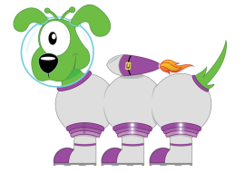
Big Maths KS1 Information Evening

Slide 2
Maths Ethos at Priestthorpe
to create independent thinkers
confident mathematicians who have an ‘I can’ attitude
mathematicians who know key facts and times
tables
children who think maths is fun!

Slide 3
Main aims of Big Maths
to enable children to recall key facts instantaneously
to enable children to tackle more complex problems because they know the basics
to give children confidence

Slide 4
4 components of our Big Maths sessions
CLIC – Counting
CLIC – Learn Its
CLIC – It’s Nothing New
CLIC – Calculations
Each section takes approximately 5 minutes

Slide 5
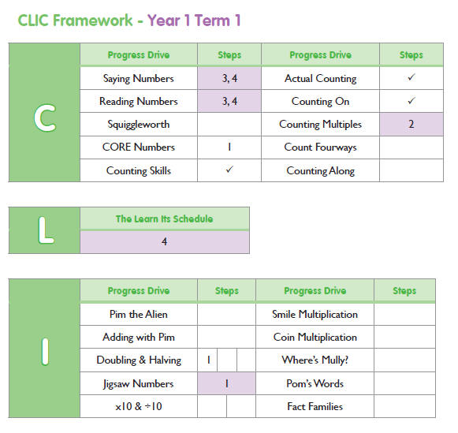
I can count in 5s
Gradually slip in the word multiple, e.g. let’s count the first five multiples of 5.

Slide 6
COUNTING
Let’s count in 5s in as many different ways as we can!

Slide 7
1 | 2 | 3 | 4 | 5 | 6 | 7 | 8 | 9 | 10
11 | 12 | 13 | 14 | 15 | 16 | 17 | 18 | 19 | 20
21 | 22 | 23 | 24 | 25 | 26 | 27 | 28 | 29 | 30
31 | 32 | 33 | 34 | 35 | 36 | 37 | 38 | 39 | 40
41 | 42 | 43 | 44 | 45 | 46 | 47 | 48 | 49 | 50
51 | 52 | 53 | 54 | 55 | 56 | 57 | 58 | 59 | 60
61 | 62 | 63 | 64 | 65 | 66 | 67 | 68 | 69 | 70
71 | 72 | 73 | 74 | 75 | 76 | 77 | 78 | 79 | 80
81 | 82 | 83 | 84 | 85 | 86 | 87 | 88 | 89 | 90
91 | 92 | 93 | 94 | 95 | 96 | 97 | 98 | 99 | 100

Slide 8
1 | 2 | 3 | 4 | 5 | 6 | 7 | 8 | 9 | 10
11 | 12 | 13 | 14 | 15 | 16 | 17 | 18 | 19 | 20
21 | 22 | 23 | 24 | 25 | 26 | 27 | 28 | 29 | 30
31 | 32 | 33 | 34 | 35 | 36 | 37 | 38 | 39 | 40
41 | 42 | 43 | 44 | 45 | 46 | 47 | 48 | 49 | 50
51 | 52 | 53 | 54 | 55 | 56 | 57 | 58 | 59 | 60
61 | 62 | 63 | 64 | 65 | 66 | 67 | 68 | 69 | 70
71 | 72 | 73 | 74 | 75 | 76 | 77 | 78 | 79 | 80
81 | 82 | 83 | 84 | 85 | 86 | 87 | 88 | 89 | 90
91 | 92 | 93 | 94 | 95 | 96 | 97 | 98 | 99 | 100
The first 10 multiples of 5

Slide 9
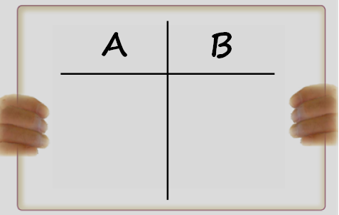
55,60,65,
70,75,80,85,90,95,100
The next 10 multiples of five.

Slide 10
If you can count in multiples of five, then you learn to can count in …..
50s
Five tens
500s
Five hundreds
0.5s
Five tenths

Slide 11
Meet Squiggleworth The place value dog who helps children to understand the value of each digit.

Slide 12
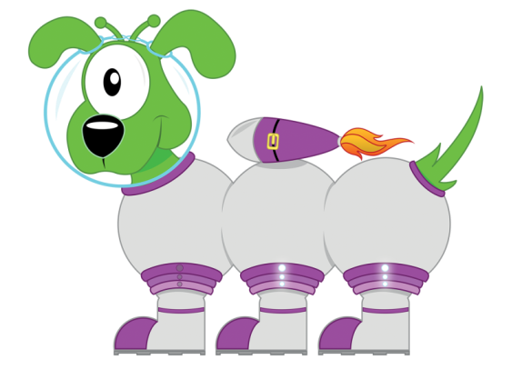
Squiggleworth
Remember to:
Write the 2d number
Draw the sticks
Copy the units digit
Copy the tens digit… with a zero on the end.
3
6
36
30
6
30
6

Slide 13
27
27
20
7
Let’s partition!
27

Slide 14
KS1 National Curriculum Expectation
By the end of Key Stage 1, children should be able to count fluently in 1s, 2s, 3s, 5s and 10s, starting from any number and bridging 100, backwards and forwards.

Slide 15
Learn Its
Some important addition facts
L
Learn Its

Slide 16
Learn Its
What are Learn Its?
key facts that children should just know
without this knowledge children can not be fluent in numbers and place value
if they have to use their fingers to count, or take too long, children do not know their Learn Its facts

Slide 17
Learn Its are broken down into steps.
Each step should last roughly one term and is made up of approximately 6 new facts.
That’s only 6 facts to learn instantaneously over the course of the term.
It’s all about wiring up your child’s brain so that they just ‘know’ the fact.

Slide 18
Learn Its – Step 2
Double 4
5+5=10
Double 5
4+4=8
3+3=6

Slide 19
Learn Its – Step 3
Counting in multiples of 10
2+3=5
2+1=3
Say Multiples 1 - 10
Say Multiples 1 - 5

Slide 20
Learn Its – Step 4
1+9=10
Counting in multiples of 5
2+8=10
3+7=10
Say Multiples 1 - 10
4+6=10
Say Multiples 1 - 5
5+5=10

Slide 21
Learn Its – Step 5
2+4=6
2+9=11
2+5=7
3+4=7
2+6=8
3+5=8
2+7=9
3+6=9

Slide 22
Learn Its – Step 6
Counting in multiples of 2
6+6=12
7+7=14
8+8=16
Say Multiples 1 - 10
9+9=18
Say Multiples 1 - 5

Slide 23
Learn Its – Step 7
1x10=10
2x10=20
3x10=30
4x10=40
5x10=50
6x10=60
7x10=70
8x10=80
9x10=90
10x10=100
11x10=110
12x10=120
3+8=11
Fact Family
3+9=12
Jumbled Tables
4+7=11
Say Table
4+8=12
Say Multiples 1 - 10
4+9=13
Say Multiples 1 - 5

Slide 24
Learn Its – Step 8
6+7=13
Fact Family
1x5=5
2x5=10
3x5=15
4x5=20
5x5=25
6x5=30
7x5=35
8x8=40
9x5=45
10x5=50
11x5=55
12x5=60
5+6=11
Jumbled Tables
5+4=9
Say Table
8+7=15
Say Multiples 1 - 10
8+9=17
Say Multiples 1 - 5

Slide 25
Learn Its – Step 9
5+9=14
Fact Family
1x2=2
2x2=4
3x2=6
4x2=8
5x2=10
6x2=12
7x2=14
8x2=16
9x2=18
10x2=20
11x2=22
12x2=24
6+9=15
Jumbled Tables
7+9=16
Say Table
5+7=12
Say Multiples 1 - 10
5+8=13
Say Multiples 1 - 5
6+8=14

Slide 26
A | B
Double 6 | Double 9

Slide 27
12
18

Slide 28
A | B
Half of 14 | Half of 16

Slide 29
7
8

Slide 30
A | B
60+60 | 800+800
Changing the ‘thing’!
This is
more challenging!

Slide 31
120
1600

Slide 32
Things you can do at home to help your child learn their Learn Its
bat your child a number in the car
ask them what the switcher number sentence is
play number games, where children have to give the score ‘answer’ quickly
give them time on the internet to play quick fire games
let them budget in Home Bargains. How much change will they get?
challenge them to count backwards and forwards without making mistakes. Can they beat you?
use the PowerPoints on the Priestthorpe website

Slide 33
Its Nothing New
Step
2
Fact Families
I
It’s Nothing New

Slide 34
What is the fact family?
30+40=70
7
+-
3
4

Slide 35
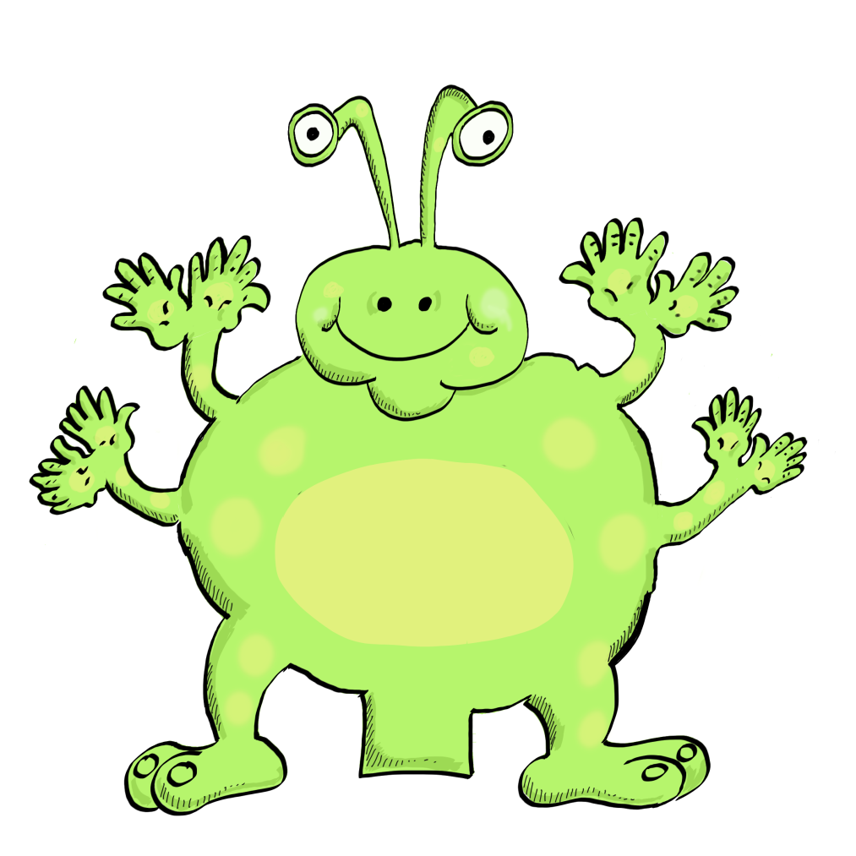
30+40=70
40+30=70
70-40=30
70-30=40

Slide 36
50+60=110
60+50=110
110-50=60
110-60=50
900+400=1300
400+900=1300
1300-400=900
1300-900=400

Slide 37
Some outer numeracy!
What else do you know?
12
+, -
4
8

Slide 38
total
increase
less than
subtracted from
difference
take away
more than
minus
decrease
sum
plus
taken from

Slide 39
The total of 4 and 8 is 12
12 take away 4 is 8
The difference between 120 and 40 is 80

Slide 40
£40+£80=£120
8Kg+4Kg=12Kg
120cm-40cm=80cm

Slide 41
Jigsaw Numbers
What is the missing piece to ten?
8
How many more to make ten?

Slide 42
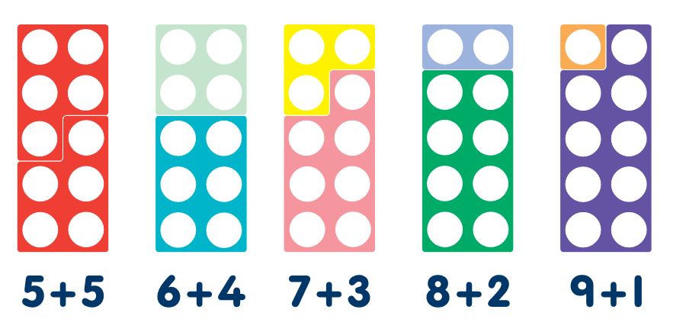

Slide 43
2
Because 8+2=10
And 2+8=10

Slide 44
What is the missing piece to the next multiple of ten?
16
How many more to make 20?

Slide 45
What is the missing piece to 100?
36
How many more to make 100?

Slide 47
What is the missing piece to 1000?
228

Slide 48
Because 200+700=
900
28+72=100
772

Slide 49
If we know how to count fluently, know basic key facts without having to think, understand place value, the number system and vocabulary, we can manipulate this knowledge to solve every mathematical problem.

Slide 50
Real life maths
16000+18000=34000
It’s Nothing New!
32+36=68
320+360=680
3.2+3.6=6.8
3.4-1.6=1.8
0.34-0.16=0.18
340-160=180
3400-1600=1800
18+16=34
16+18=34
34-16=18
34-18=16
An apple costs 18p and a banana costs 16p. The total cost of an apple and banana is 34p
3400-1600=1800
Mary has £3.40. She spends £1.80, so she will have £1.60 left
118+16=134
16+118=134
134-16=118
134-118=16
I know: 18+16=34
A can of holds 340ml of cola. Jon drinks 160ml so there are 180ml left in the can.
0.016+0.018=0.034
Rachael is 1.16m tall and Jamie is 1.18m tall. The total of their heights is 2.34m
3400 minus 1800 equals 1600
The weights of three parcels are 6Kg, 10Kg and 18Kg. Their total weight is 34Kg
If you increase 0.18 by 0.16 you get 0.34
340 take away 160 equals 180
The total distance around this rectangle is 34cm
The sum of 1.6 and 1.8 is 3.4
9cm
The difference between 18 and 34 is 16
8cm
The total of 18 and 16 is 34
Using key vocabulary

Slide 51
Maths Homework Expectations
Use the four little tests at separate times of the week.
Don’t worry if your child does not complete the test in the time given.
Praise your child if they don’t use their fingers to count.
Sometimes our own expectations can put pressure on our children, so let them achieve by praising any improvements.
Praise for one more right than last week, or it was completed in less time.
If you child doesn’t complete the test, time them to see how long they take this time and encourage them to beat that time next week.
Play board games.
Tell the time.
Let them work out the change when shopping.
Have fun!

